Slide 1

{Dev}School DevOps Edition 2023
Andrada Raducanu, Delia Bizu, Liviu Varia
February 2023

Slide 2

Agenda
Who are we?
Who are you?
The program
The calendar
Welcome word

Slide 3

Who are we?
{Dev}School DevOps Edition Core team

Slide 4
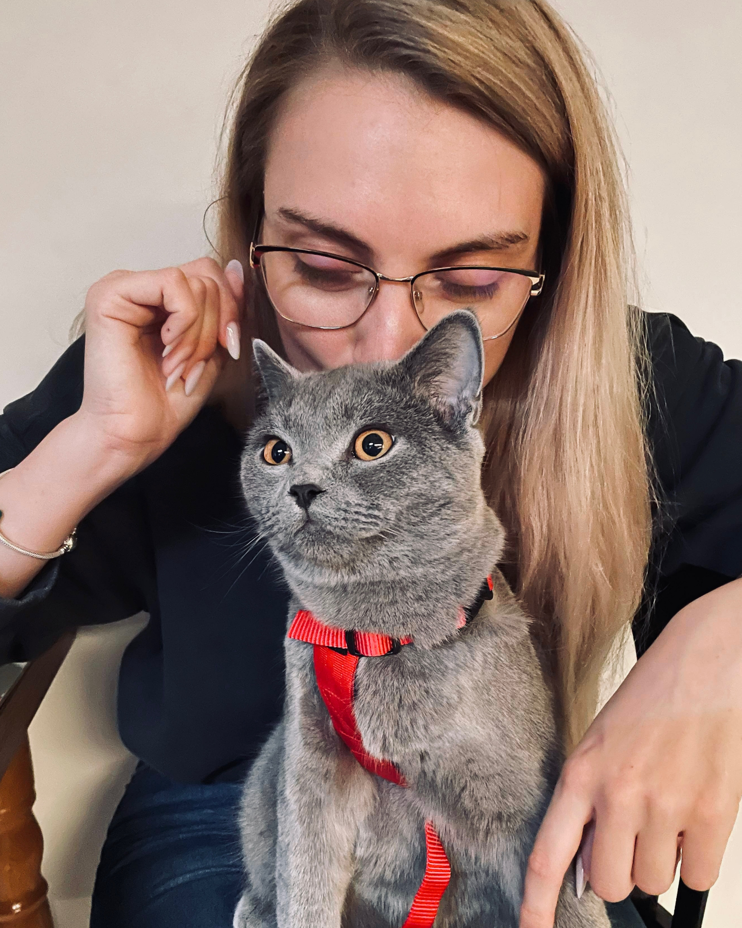
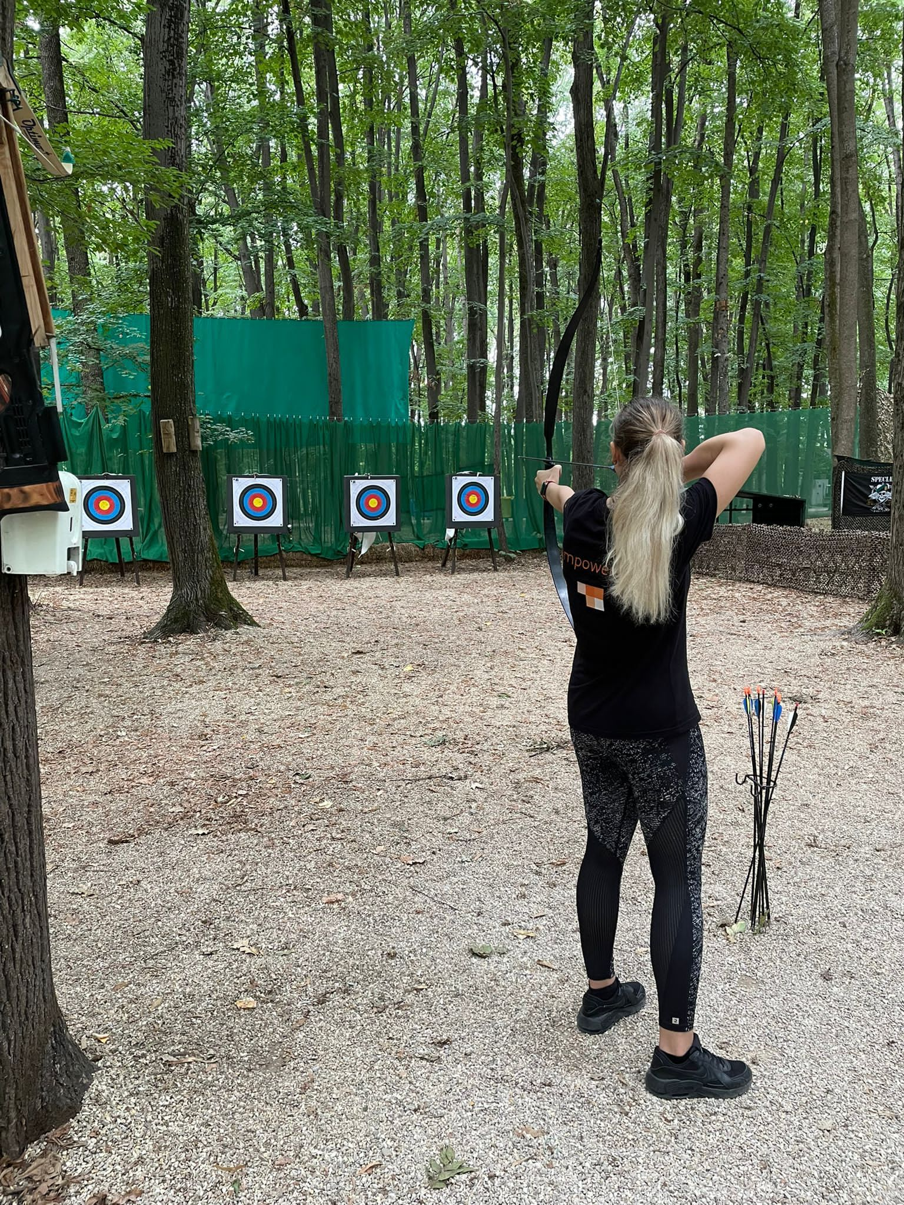
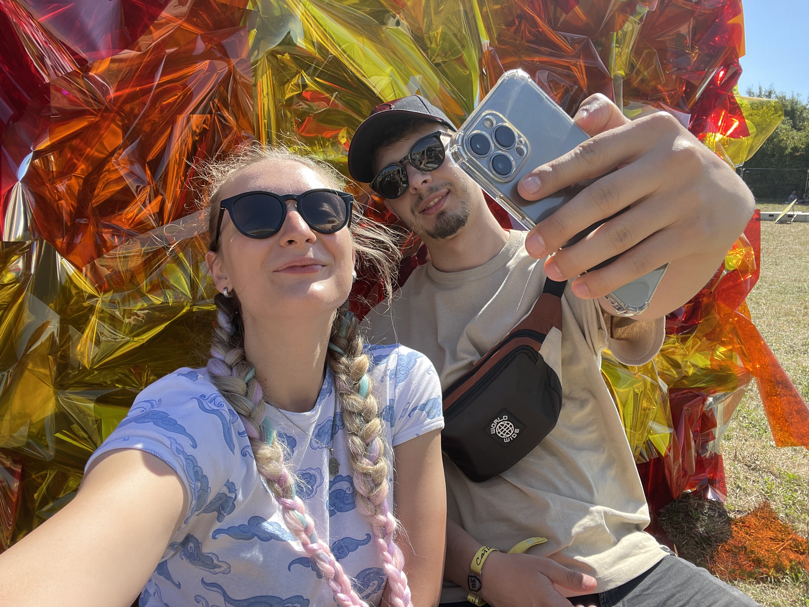
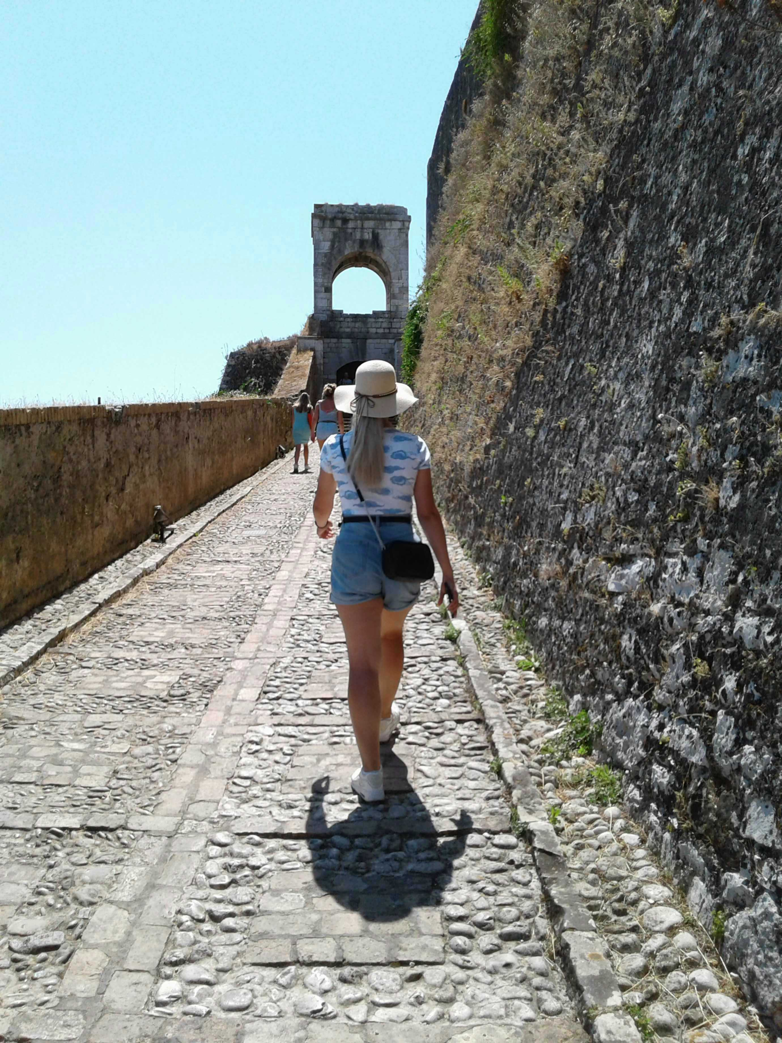
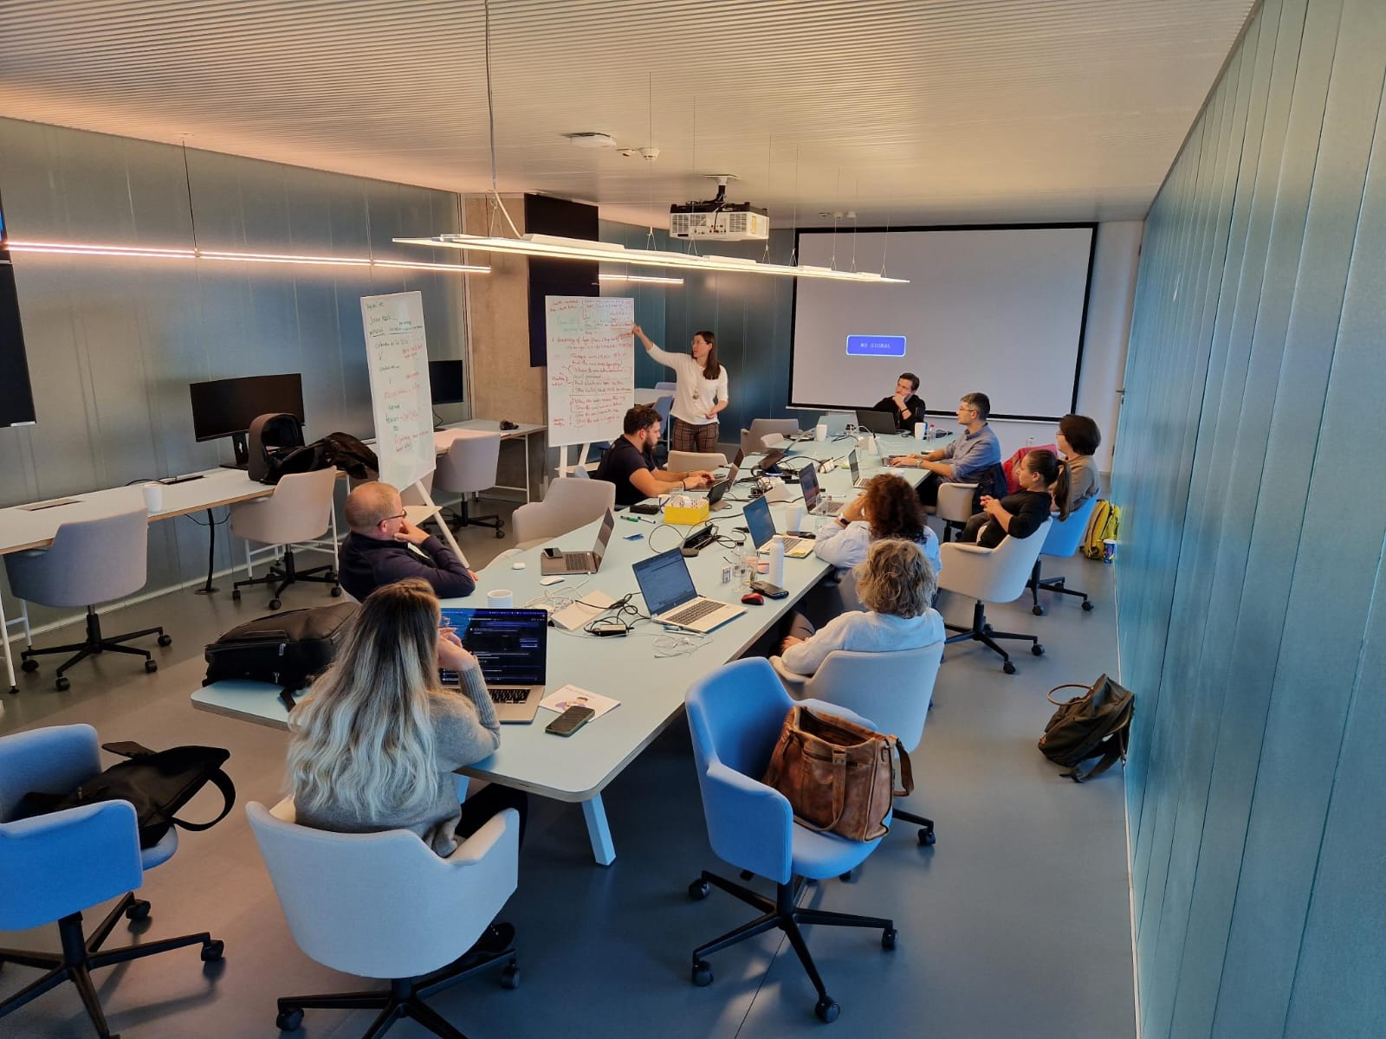
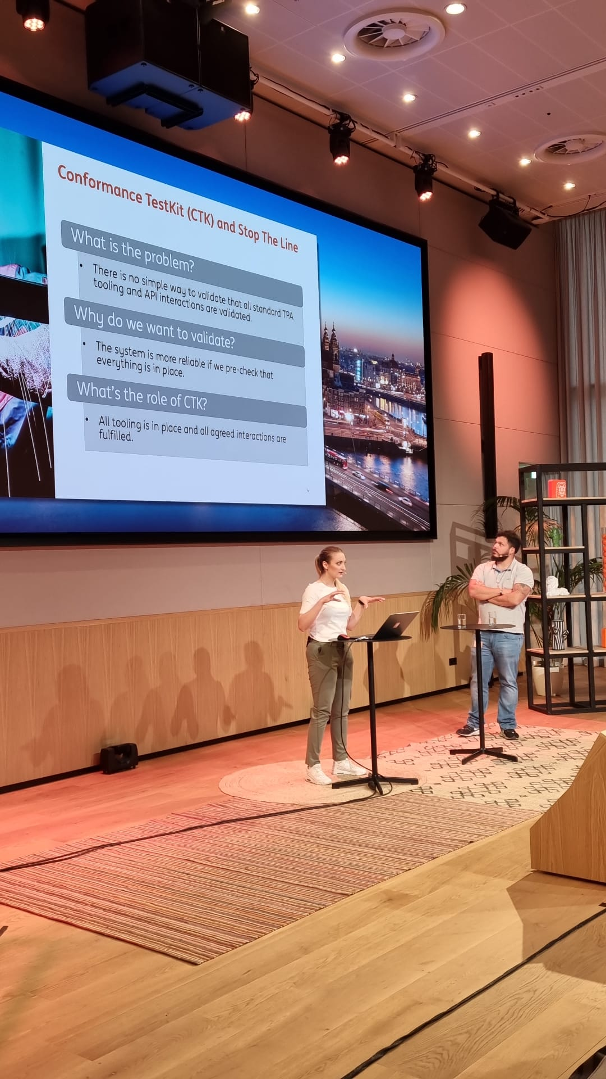

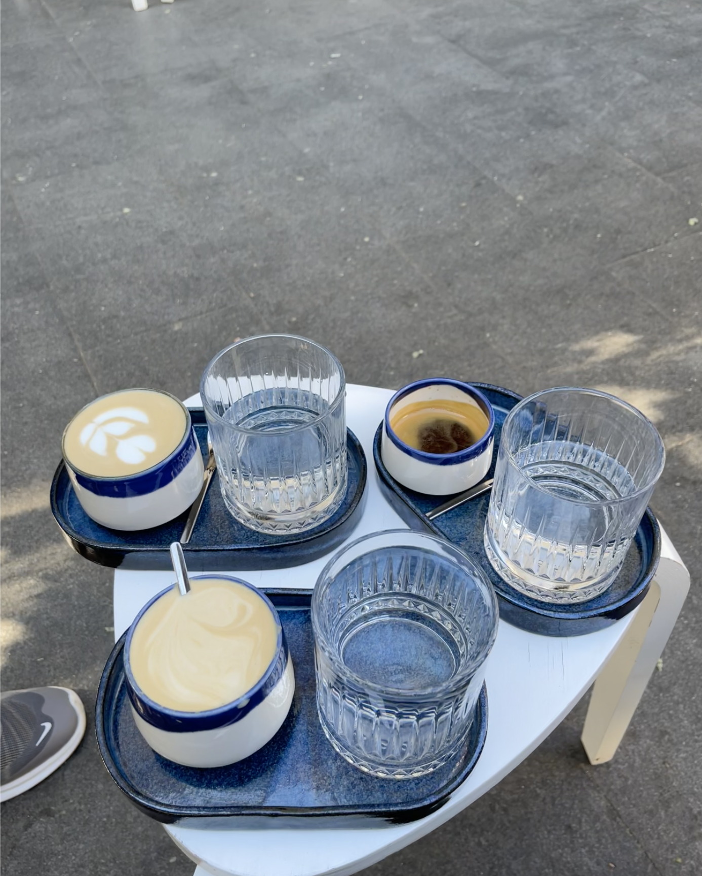
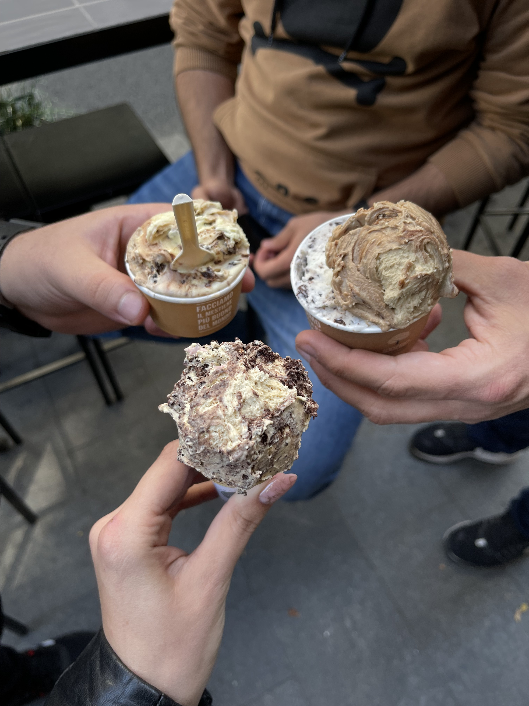
Andrada Raducanu

Slide 5


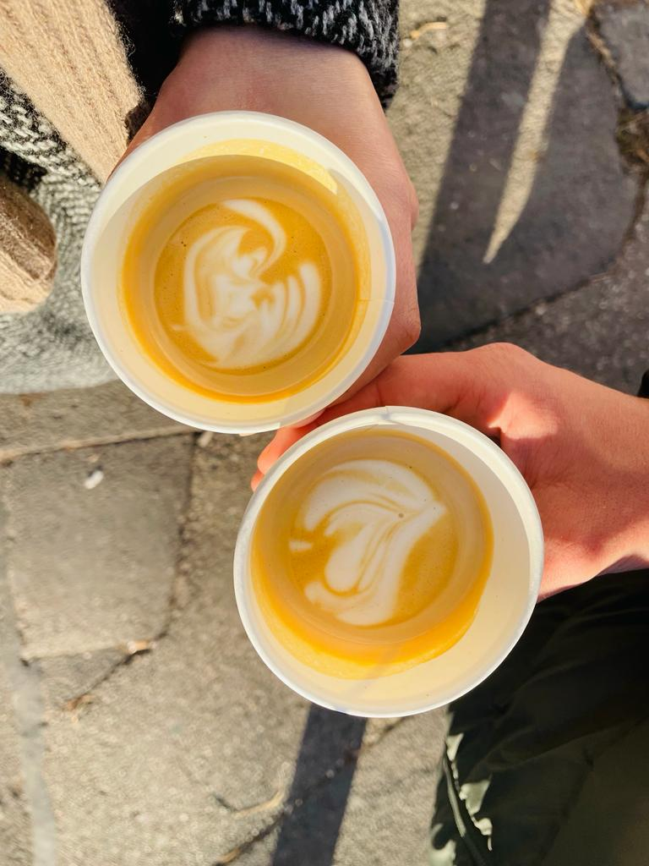

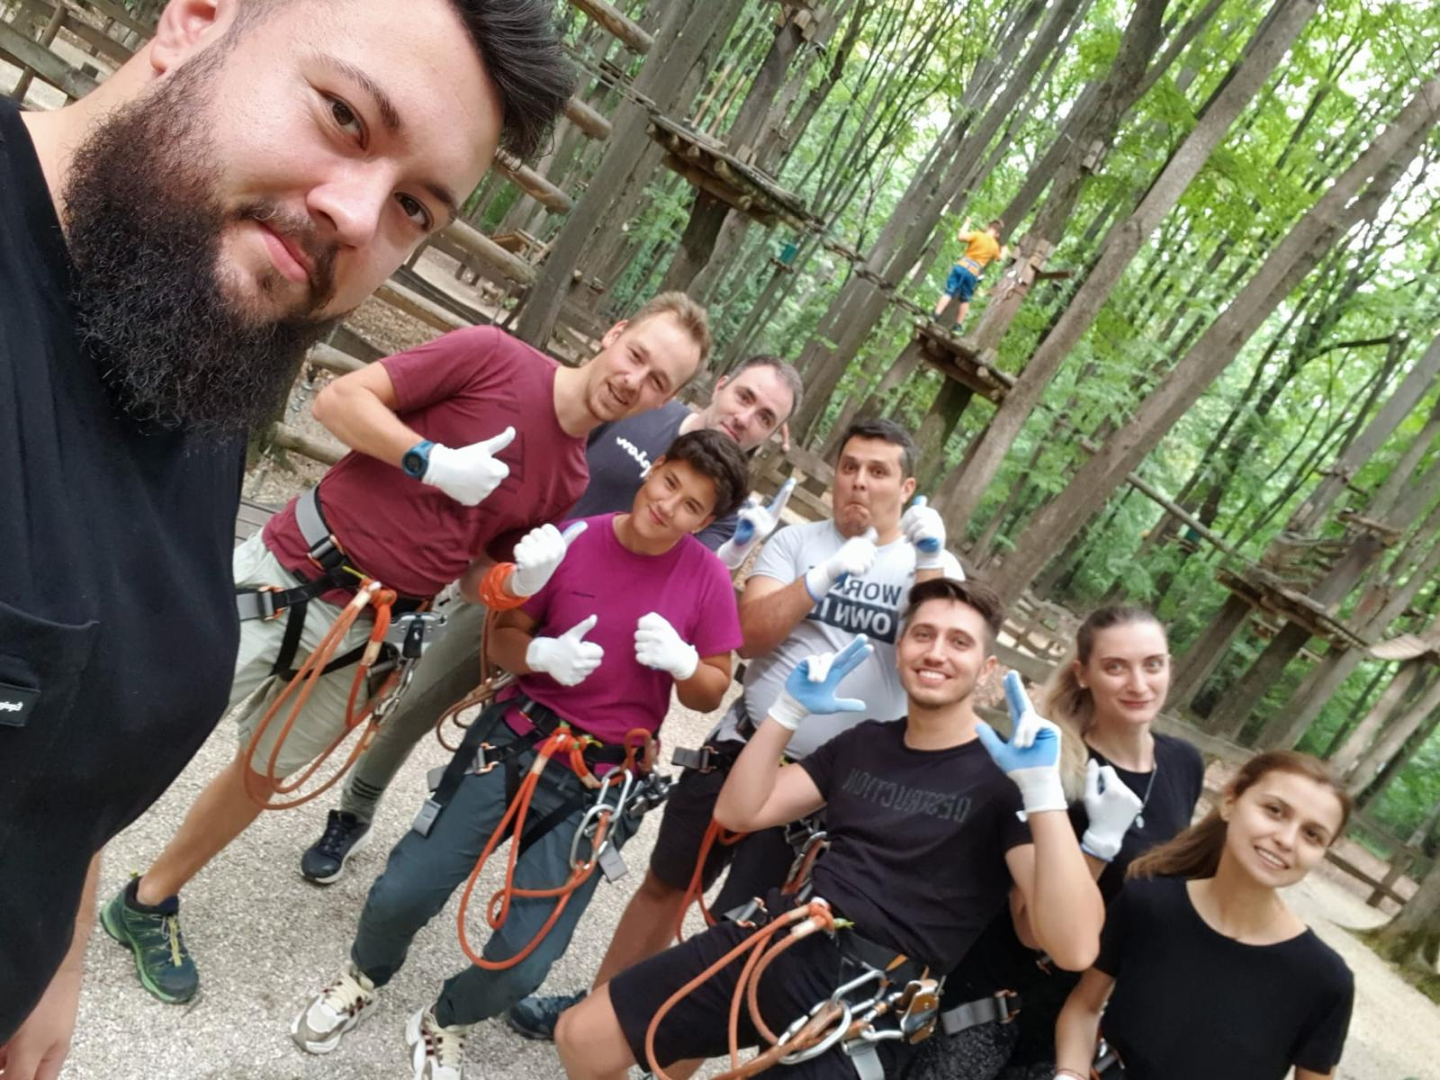
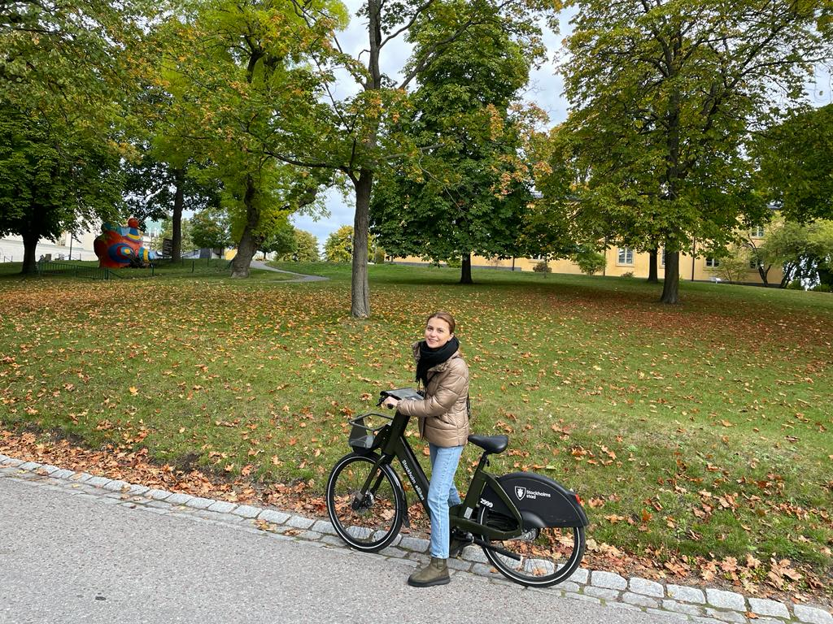
Delia Bizu

Slide 6
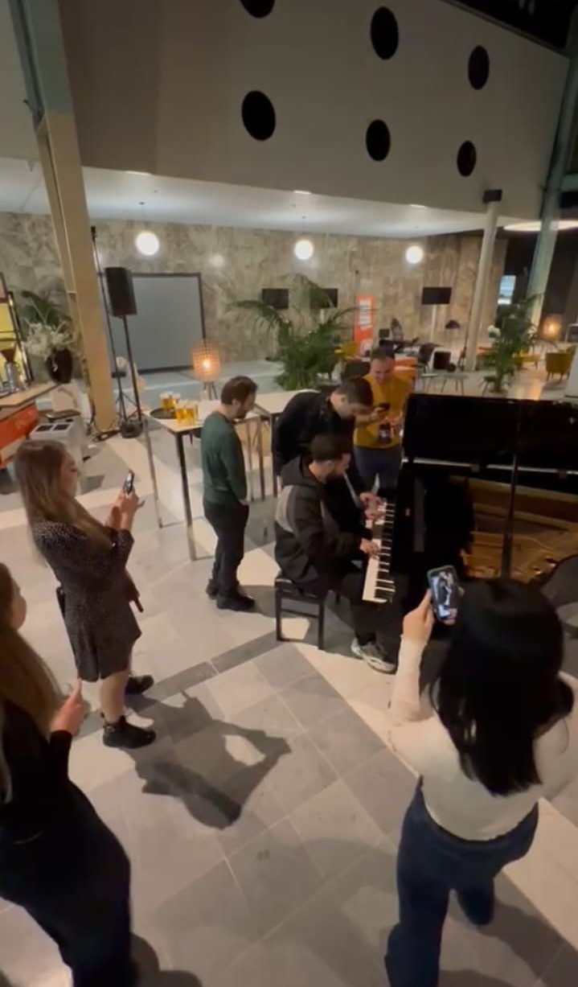
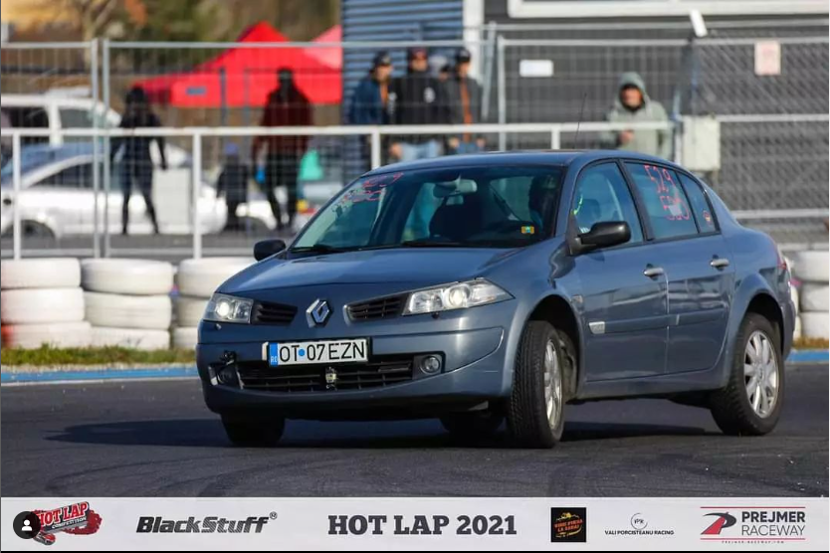
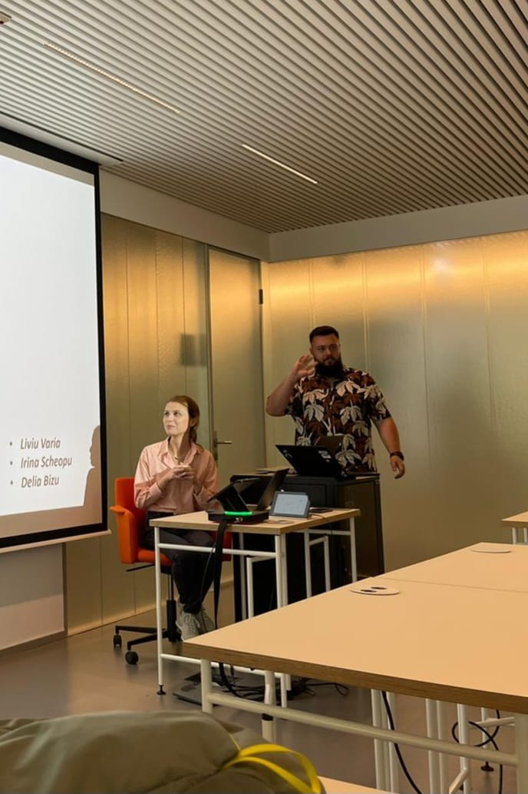
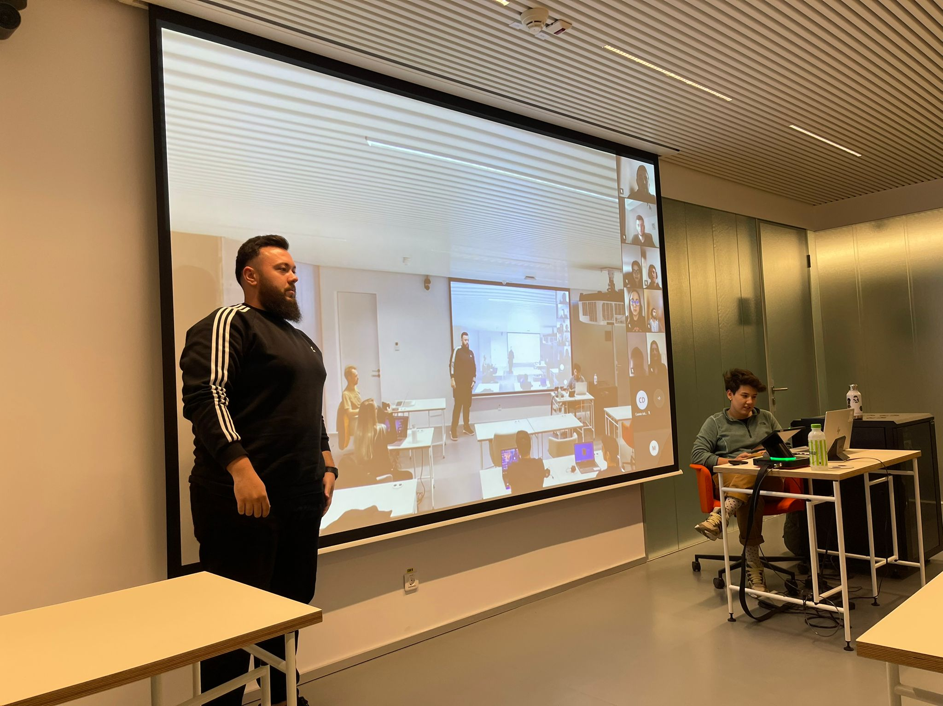
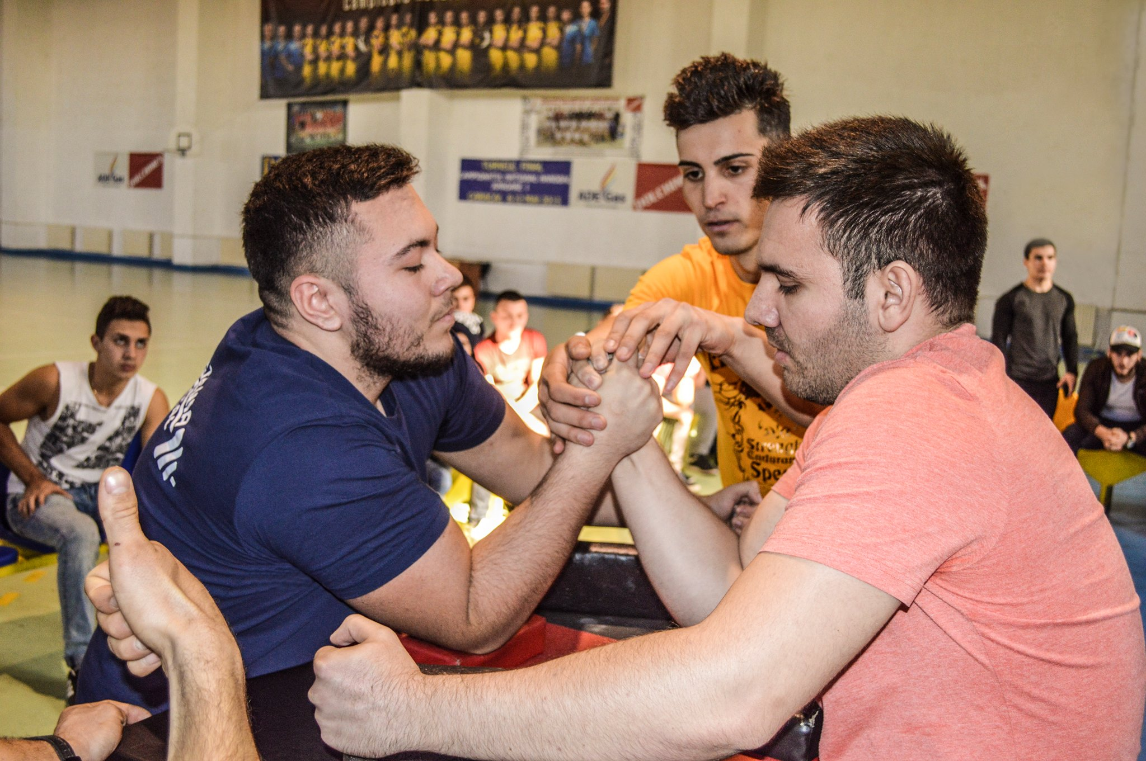
Liviu Varia

Slide 7
Who are you?
Hobbies, passions, interests

Slide 8
Welcome word
from Maria Gheorghe, IT Lead of Data Management

Slide 9
The program
13 lessons (theoretical and practical, some of them will have homeworks);
lesson 11 reserved for planning the final project;
lesson 13 reserved for presenting the final project;
almost each lesson has a different trainer;
time from lesson 11 will also be used for presenting vacancies suited for you from ING Hubs;
after the DevSchool is over, you will get the chance to apply to one of the presented vacancies and continue with the recruitment proccess;
all the needed materials for the lessons will be stored in GitHub;
either Andrada, Delia or Liviu will be present at any lesson if you have questions about the program;

Slide 10
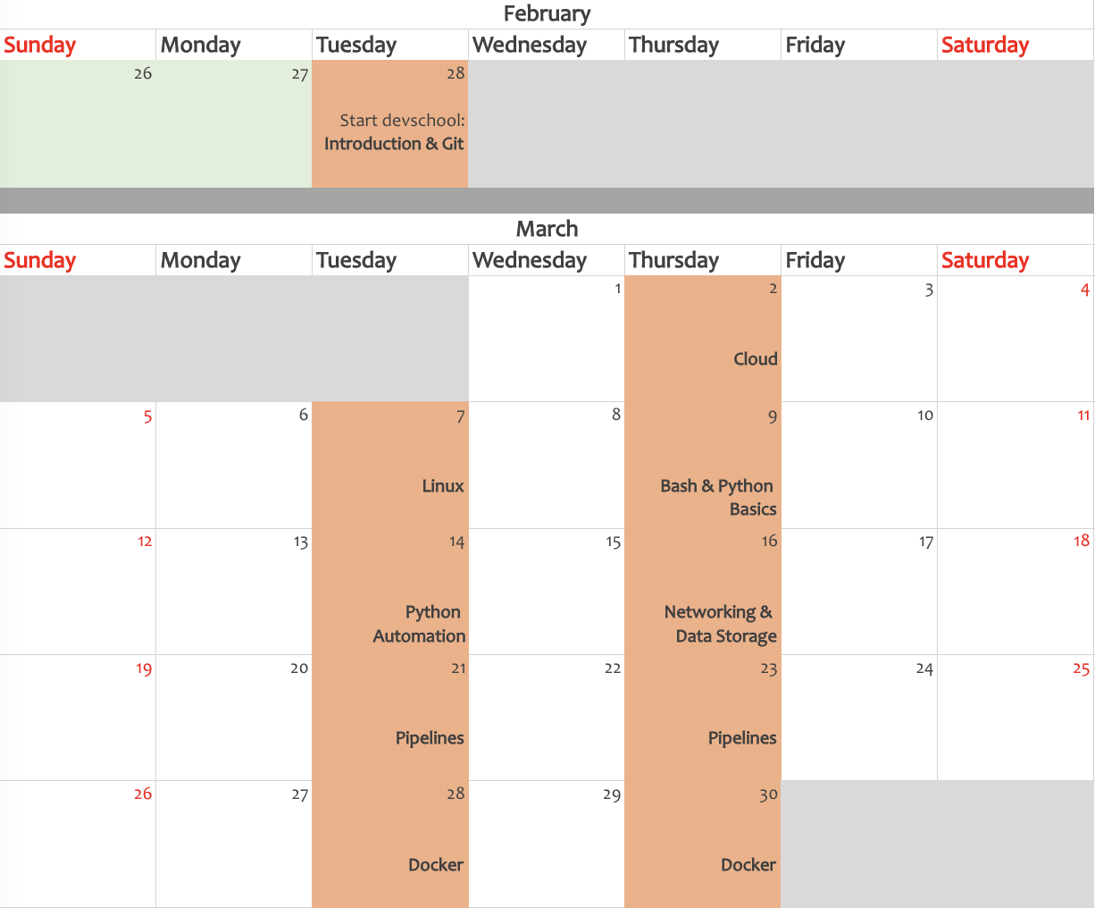
The calendar

Slide 11
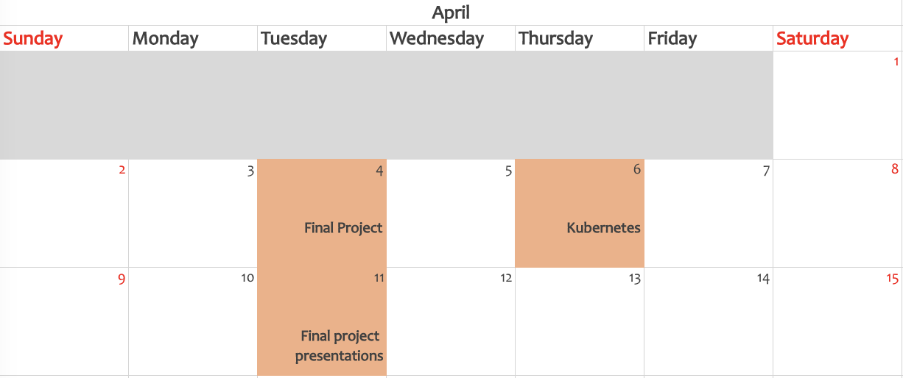
The calendar

Slide 12








Thank you!
ing.com
@ING_News
LinkedIn.com/company/ING
SlideShare.net/ING
Medium.com/ing-blog
ingwb.com
Facebook.com/ING
YouTube.com/ING
Flickr.com/INGGroup

